Slide 1
Project Management
Delivery & Shipping company

Slide 2
Project team 41
ريموندا وجيه رسمي نبيه
سارة رؤف شاكر حنا
رنا أسامة محمد فهمي
رولا نشأت نصحي رياض
عبدالعزيز عبدالرحمن عبدالعزيز عبدالرحمن
Remonda Wageh
Sarah Raouf
Rana Osama
Rola Nashaat
Abd El Aziz Abd El Rahman

Slide 3
Project description
A service that finds the best delivery option in your local area based on the type, location, size and weight of the product to be delivered with an affordable price.
There is a team in each city that is responsible for delivering parcels within the city and there is another team that delivers mail outside the city to anywhere in Egypt.
The application sends a notification to the sender the moment the parcel is delivered to the destination.

Slide 4
Business Case
People are looking for an easy and fast way to send and receive parcels without getting lost or being sent to the wrong place, so this application delivers the package to the right destination at an affordable price from your place to your destination.

Slide 5
Available Resources
Budget
Budget allocated for this project is 305,000$.
Software
Software licenses for android apps.

Slide 6
Milestone Timeline
Jan 2022: project start.
After 2 months: check point 1.
After 6 months: check point 2.
After 8 months: check point 3.
After 8 months and 2 weeks (35 Weeks): launch the application.

Slide 7
Product Acceptance Criteria
Ease of use as the user can use it from home.
The user does not need to do anything other than fill in the parcel information and specify its location and destination.
Express delivery.
Timely delivery.
Affordable price.

Slide 8
Project Deliverables
A shipping and delivering company and an android application
that helps people to deliver their package to their destination with an affordable price.

Slide 9
Project Exclusions
This application is not responsible for the lack of credibility of the parcel, and it is an application its purpose is to deliver only.
This application does not allow the transfer of parcels until after checking them and making sure of their safety (does not contain any prohibitions).
This application works only inside Egypt.

Slide 10
Project Constraints
The budget doesn’t exceed the allocated budget.
The project must be delivered on time.
This application works only inside Egypt.

Slide 11
Project Assumptions
In the future, the app will work on iOS devices as well.
We plan to be an international company.

Slide 12
WBS
1.1 Planning
1.1.1 Project Team
1.1.2 Project Plan
1.2 Execution
1.2.1 User Requirement
1.2.2 Create Graphic Design
1.3 Development
1.3.1 Building Database
1.3.1.1 Create Tables
1.3.1.2 Create Relations
1.3.1.3 Test Database
1.3.2 Building Front End Interface
1.3.3 Building Back End and Dashboard
1.3.4 Testing Application
1.3.5 Push the application on the server
1.4 Control
1.4.1 Resources management
1.4.2 Cost management
1.4.3 Risk management
1.5 Closure
1.5.1 Finalize product
1.5.2 Review & Accept
1.5.3 Documentation

Slide 13
WBS Dictionary
ID | WBS | Description | Cost | Duration
1 | 1.1.1 | Project Team | 3,000$ | 1 Week
2 | 1.1.2 | Project Plan | 2,000$ | 1 Week
3 | 1.2.1 | User Requirement | 10,000$ | 1 Week
4 | 1.2.2 | Create Graphics Design | 10,000$ | 4 Weeks
5 | 1.3.1 | Building Database | 50,000$ | 4 Weeks
6 | 1.3.1.1 | Create Tables |  | 2 weeks
7 | 1.3.1.2 | Create Relations |  | 1 week
8 | 1.3.1.3 | Test Database |  | 1 week
9 | 1.3.2 | Building Front End Interface | 20,000$ | 3 Weeks
10 | 1.3.3 | Building Back End and Dashboard | 20,000$ | 4 Weeks

Slide 14
WBS Dictionary
11 | 1.3.4 | Testing Application | 10,000$ | 2 weeks
12 | 1.3.5 | Push the application on the server | 30,000$ | 4 Weeks
13 | 1.4.1 | Resources management | 40,000$ | 4 Weeks
14 | 1.4.2 | Cost management | 60,000$ | 2 Weeks
15 | 1.4.3 | Risk management | 30,000$ | 2 Weeks
16 | 1.5.1 | Finalize product |  | 4 Weeks
17 | 1.5.2 | Review & Accept |  | 3 weeks
18 | 1.5.3 | Documentation | 20,000$ | 1 week

Slide 15
Responsibility Matrix
 | Project Manager | Leader | sponsor | Developer | Testers | Marketing
planning | A | A
User requirement | A | C
Graphic design | R | A | R | C
database | A | P | R | C
Front end | A | A | R | C
Back end | A |  | R | C
Testing | P | P | P | P | P
Advertisements | R |  | A |  |  | P

Slide 16
The legend of the previous matrix
A = Approves
R = Reviews
P = Participant
C = Create

Slide 17
Network
Activity | Description | Preceding Activity | Activity Time (week)
A | Planning | None | 2
B | User Requirement | A | 1
C | Graphic Design | A | 4
D | Database | B | 4
E | Front End | C | 3
F | Back End | D, E | 4
G | Testing | F | 2
H | Push | G | 4
I | Control | H | 8
J | Closure | I | 8

Slide 18
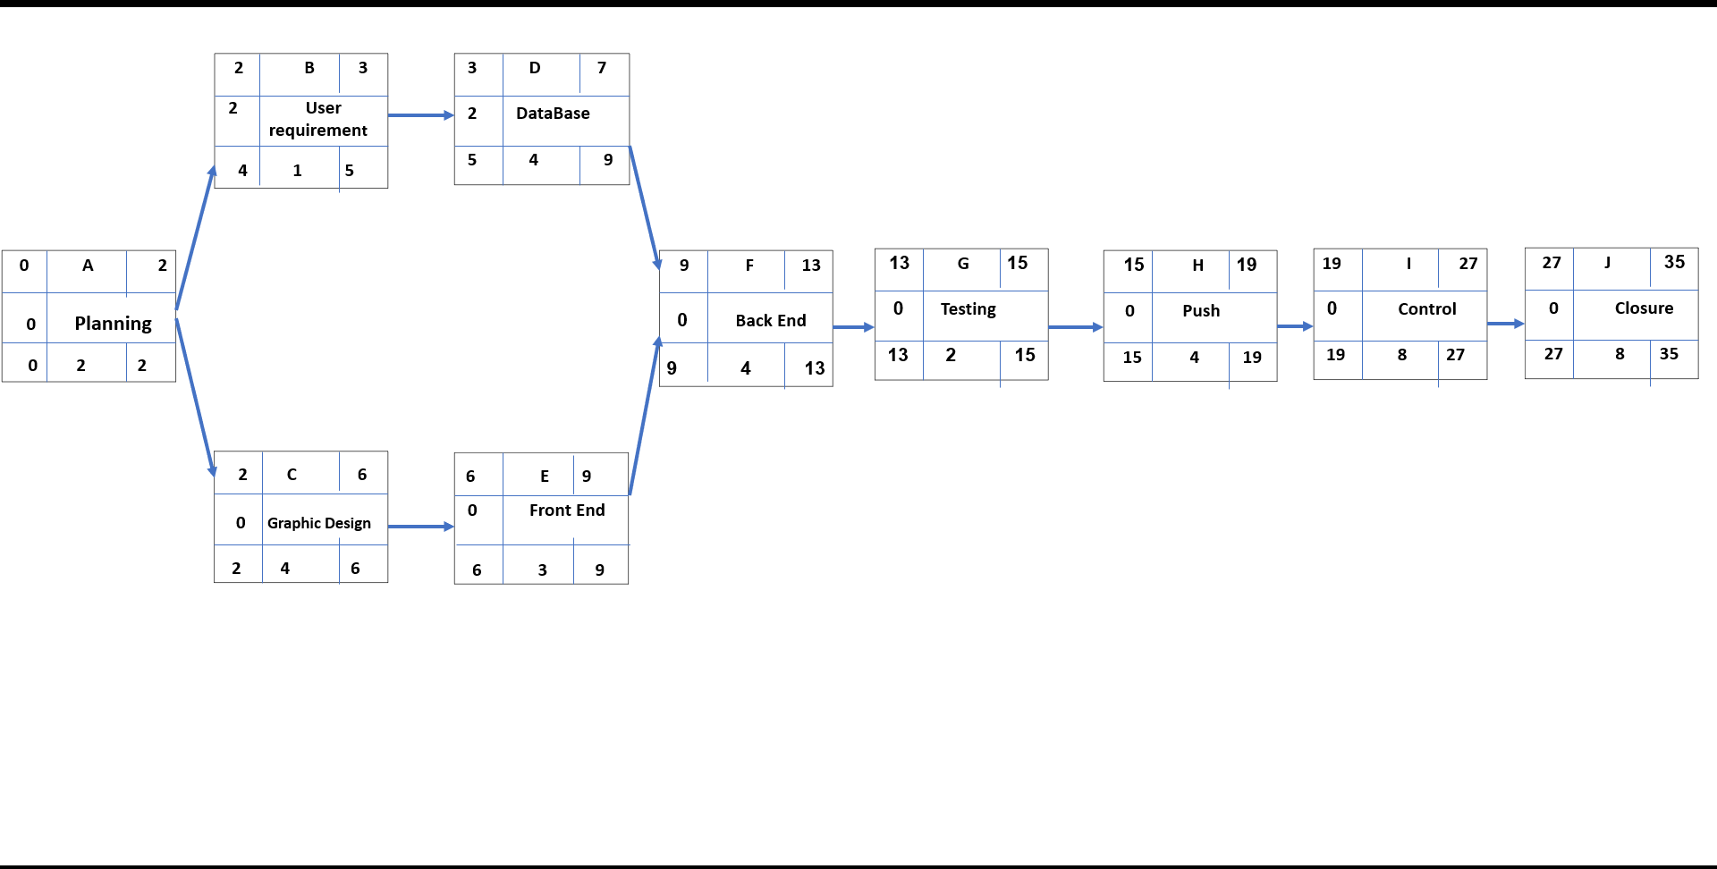
Network

Slide 19
Gantt Chart
ID | Duration | Task Name | Start | Finish | Late Start | Late Finish | Free Slack | Total Slack
A | 2 weeks | Planning | 1/1/2022 | 14/1/2022 | 1/1/2022 | 14/1/2022 | 0 | 0
B | 1 week | User requirement | 15/1/2022 | 21/1/2022 | 28/1/2022 | 3/2/2022 | 2 weeks | 2 weeks
C | 4 weeks | Graphic Design | 22/1/2022 | 18/2/2022 | 22/1/2022 | 18/2/2022 | 0 | 0
D | 4 weeks | Database | 19/2/2022 | 18/3/2022 | 4/3/2022 | 31/3/2022 | 2 weeks | 2 weeks
E | 3 weeks | Front End | 19/3/2022 | 8/4/2022 | 19/3/2022 | 8/4/2022 | 0 | 0
F | 4 weeks | Back End | 9/4/2022 | 6/5/2022 | 9/4/2022 | 6/5/2022 | 0 | 0
G | 2 weeks | Testing | 7/5/2022 | 20/5/2022 | 7/5/2022 | 20/5/2022 | 0 | 0
H | 4 weeks | Push | 21/5/2022 | 17/6/2022 | 21/5/2022 | 17/6/2022 | 0 | 0
I | 8 weeks | Control | 18/6/2022 | 12/8/2022 | 18/6/2022 | 12/8/2022 | 0 | 0
J | 8 weeks | Closure | 13/8/2022 | 7/10/2022 | 13/8/2022 | 7/10/2022 | 0 | 0

Slide 20
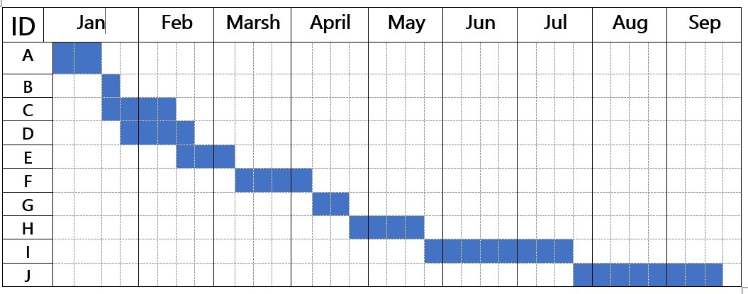
Gantt Chart

Slide 21
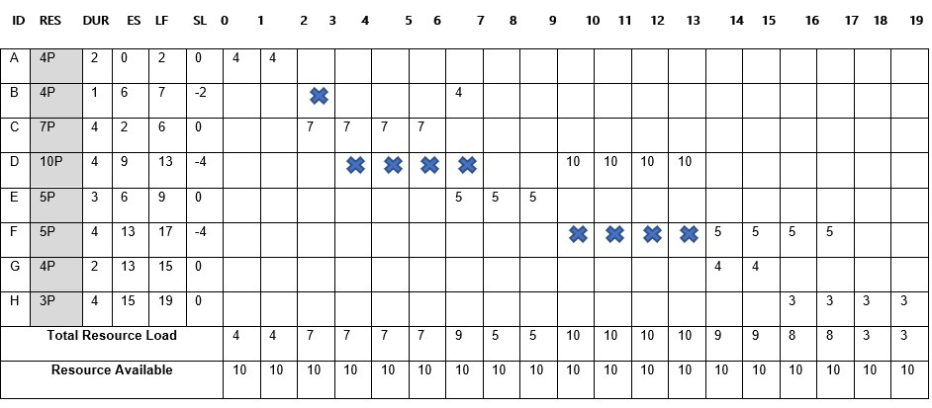
Resource Constrained

Slide 22
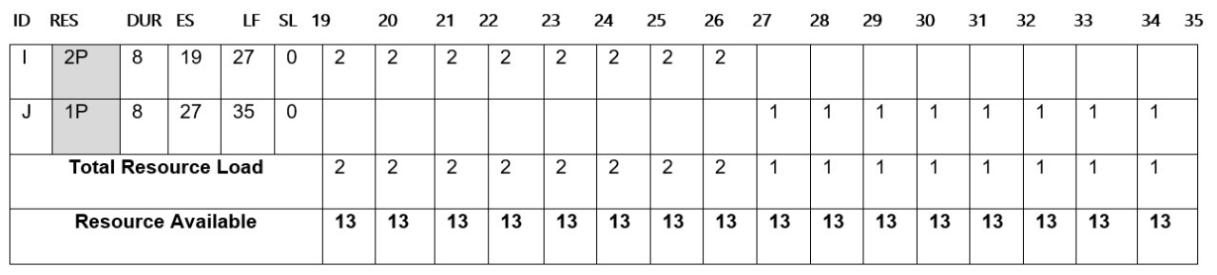
Resource Constrained

Slide 23
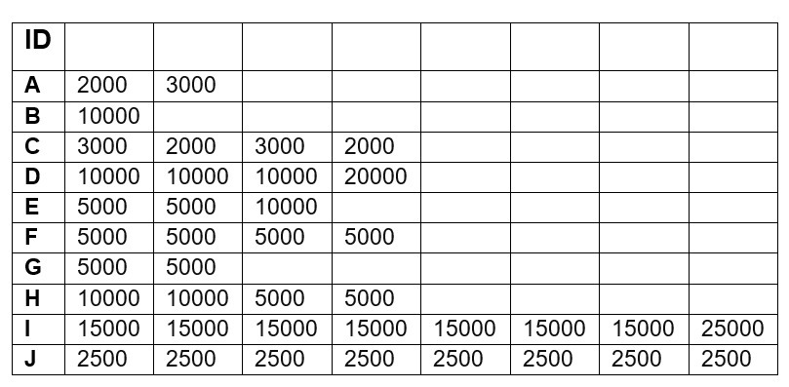
Matrix of Activity with Cost

Slide 24
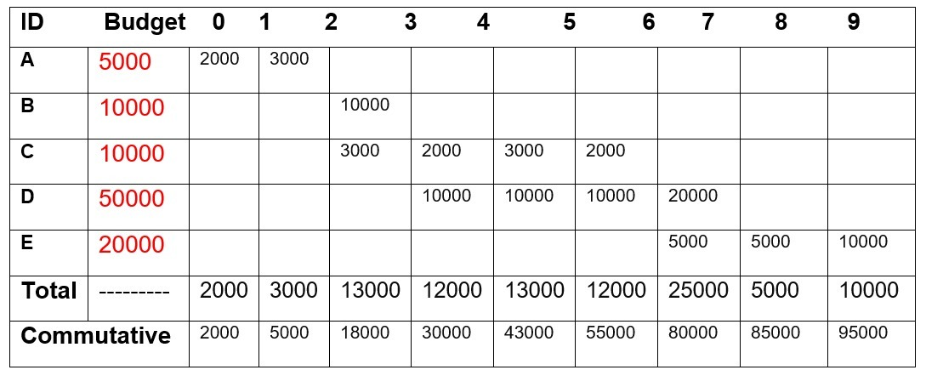
Baseline Budget

Slide 25
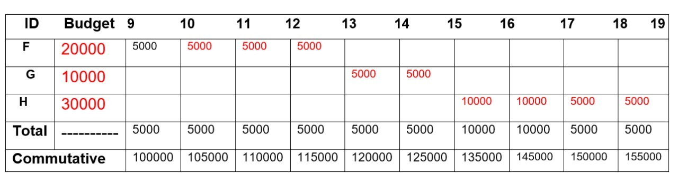
Baseline Budget

Slide 26
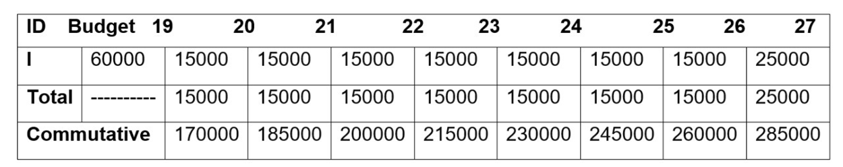
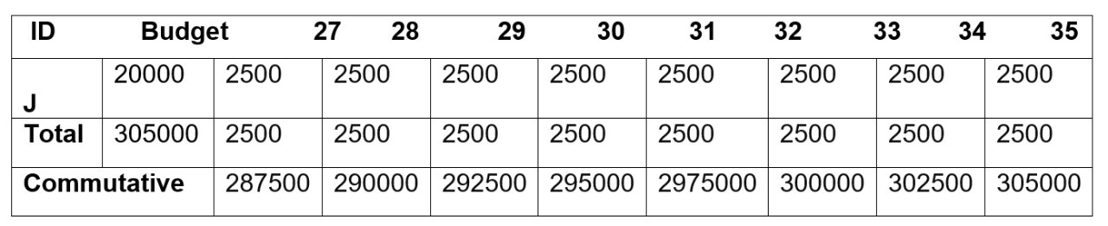
Baseline Budget

Slide 27
Risk Management & Monitoring
Risks: -
Untimely and inaccurate delivery
Damaged merchandise
Misrouted goods
Insufficient protection against cargo theft
Weather Delay

Slide 28
Risk Management & Monitoring
How to deal with them: -
We will try to gather as much information as possible about the package or the product we are shipping or delivering and make sure to provide the proper environment to keep the package in a good condition.
We will ask the customer for detailed information about the destination and the receiver to avoid misrouting.
We will try our best to keep everything safe with the responsibility of everyone working, and deliver everything from one place to another safely.
Delays because of many reasons happen and all we can do is to deliver it as fast as possible after solving all the problems or waiting for an appropriate time to keep our workers safe and avoid accidents.
Mistakes happen but we have to provide our employees with the right training to realize them and solve all the problems fast with minimal losses.

Slide 29
Risk Management & Monitoring
This is how we will monitor our project: -
We will make a plan and set goals and expectations and we have to keep tracking the process from time to time. Everyone has to know their job and roles. Decide on any appropriate steps to make sure the project stays within its expected scope. Make sure that team members, management and stakeholders all know the current status of the project and the work completed.

